Slide 1
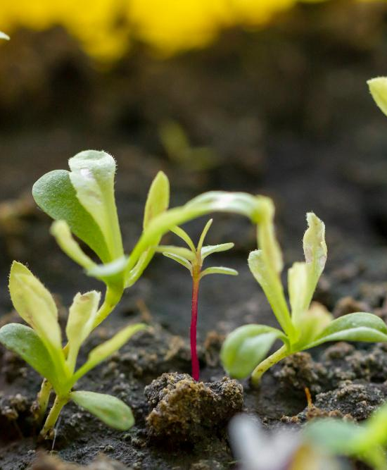
AgroBot:
A multilingual farming assistant
Empowering farmers with intelligent, accessible, and multilingual support for crop management.

Slide 2
Our AgroBot project seamlessly integrates Machine Learning technologies to provide comprehensive assistance to farmers. This innovative solution combines visual analysis with natural language understanding, breaking down communication barriers.
Revolutionizing Agricultural Support

Slide 3
The Power of Image Classification
At the core of AgroBot's visual intelligence is a robust Image Classification system. We leverage Convolutional Neural Networks (CNNs) for their unparalleled ability to interpret visual data.
Superior Feature Extraction
Enhanced Accuracy
CNNs excel at identifying intricate spatial patterns in crop images, from leaf discoloration to pest infestations.
Consistently outperforming traditional machine learning, CNNs provide reliable diagnoses for various crop issues.
Optimized Performance
Their efficiency in processing visual information ensures quick and accurate analysis, crucial for timely intervention.

Slide 4
Beyond visual diagnostics, AgroBot comprehends and responds to farmers' textual queries using advanced Natural Language Processing (NLP) techniques.
Efficient Query Handling:
NLP models swiftly process user questions, extracting intent and key information to formulate relevant responses.
Understanding Through Natural Language Processing

Slide 5
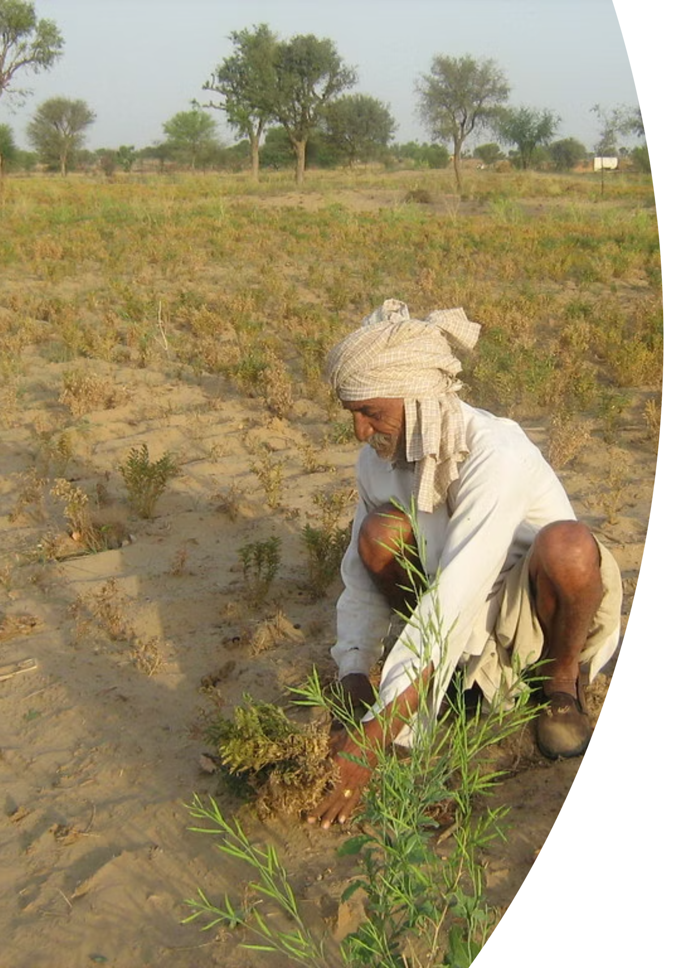
Breaking Language Barriers: Multilingual Capability
A cornerstone of AgroBot's design is its commitment to inclusivity, offering support in diverse regional languages. This multilingual feature ensures that language is never a barrier to accessing vital information.

Slide 6
Seamless Translation with Google Translate API
AgroBot's impressive multilingual functionality is powered by the Google Translate API, enabling real-time, accurate communication.
Language Selection
Bidirectional Translation
CNNs excel at identifying intricate spatial patterns in crop images, from leaf discoloration to pest infestations.
Queries are translated to English for processing, and responses are translated back into the user's language.
Extensive regional support
Facilitates seamless interaction across numerous Indian regional languages.

Slide 7
User-Friendly Interface and Backend Logic
AgroBot prioritizes ease of use with an intuitive front-end, supported by a powerful backend that orchestrates all interactions and AI processes.
Front-end: Streamlit
Back-end: ML models integration
Simple User Interface built using Streamlit
CNN model for image classification and NLP model for text responses

Slide 8
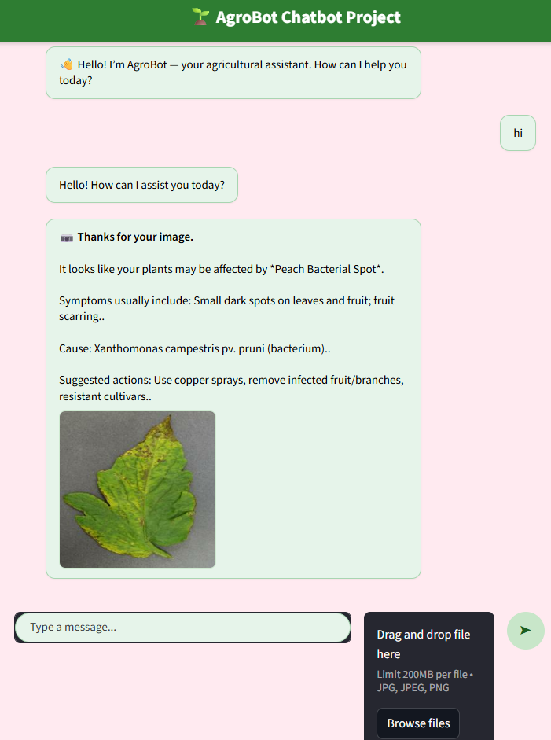
User Interface
Appearance of the chatbot on our devices

Slide 9
Key benefits of AgroBot
Enhanced Accessibility
Timely Problem Solving
Information is available in local languages, democratizing access to expert advice for all farmers.
Rapid diagnosis of crop issues through image classification allows for quick, informed decisions.
Improved Crop Health
Cost Effective Support
Proactive advice and solutions contribute to better crop management and yield optimization.
Reduces the need for physical visits by experts, offering a scalable and economical solution.

Slide 10
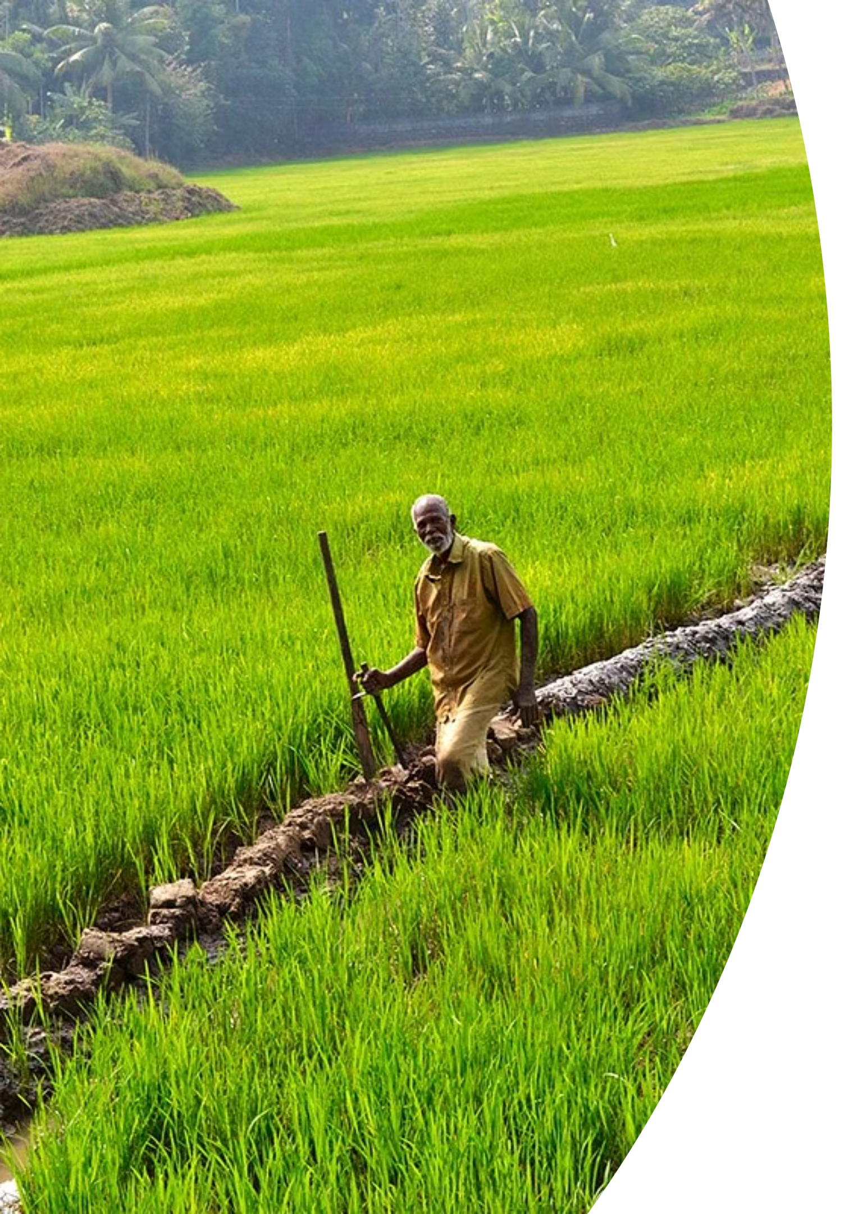
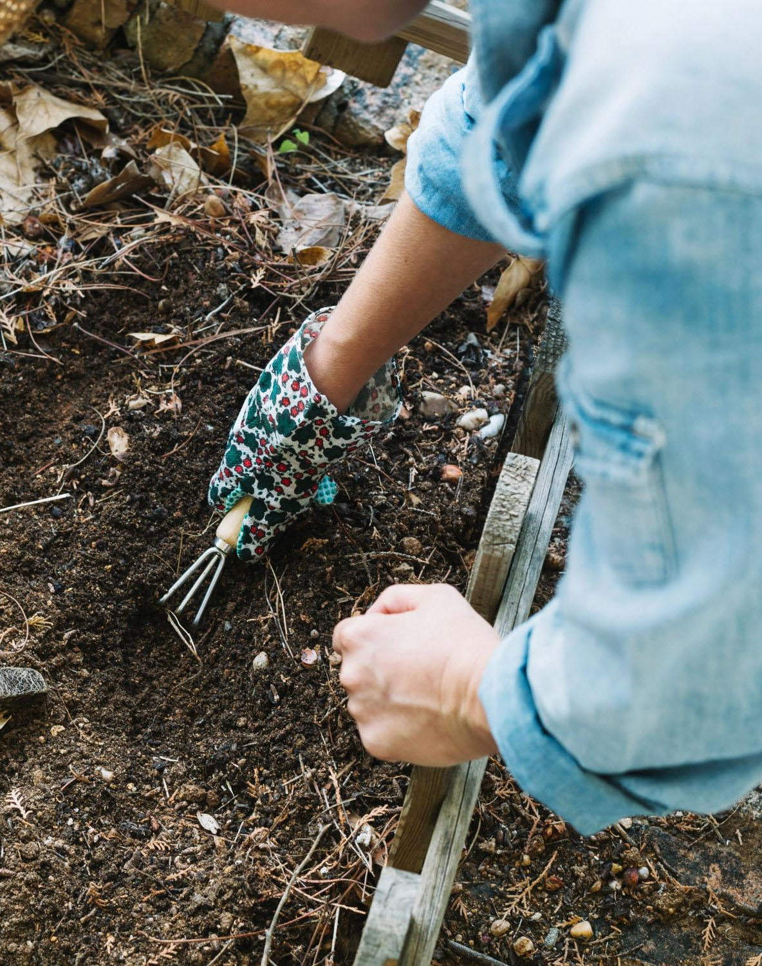
AgroBot:
Cultivating the Future of Farming
AgroBot represents a significant leap forward in agricultural technology, providing a smart, accessible, and multilingual tool designed to empower farmers and foster sustainable growth.

Slide 11
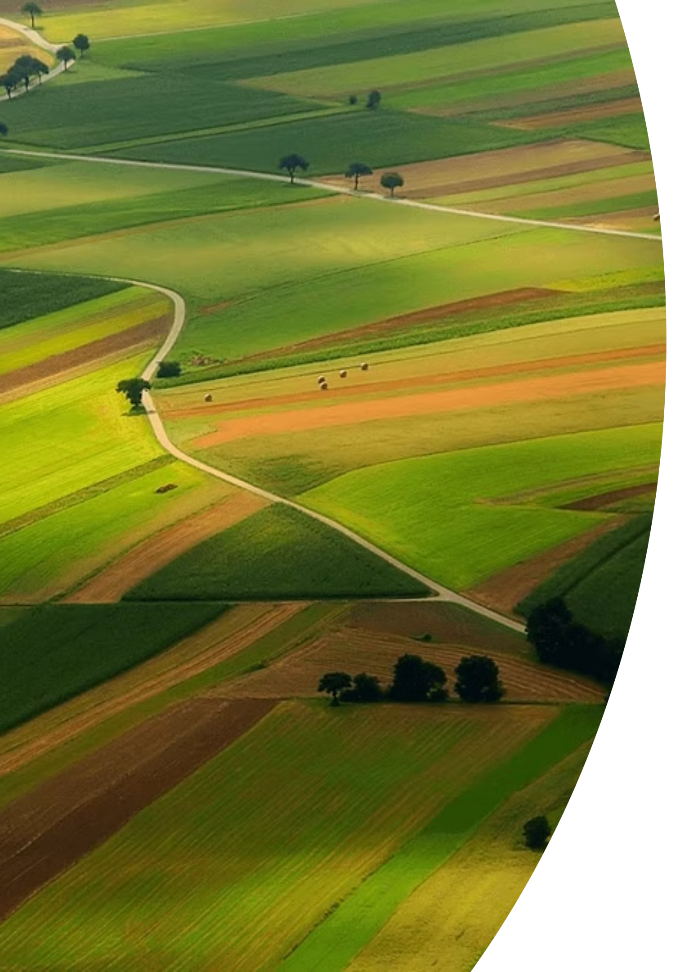
Thank
You!

